Slide 1

MICRO-CREDIT DEFAULTER PROJECT
Presented by:
Mr. Paras Malhotra

Slide 2
Problem Statement
A Microfinance Institution (MFI) is an organization that offers financial services to low-income populations.
Many microfinance institutions (MFI), experts and donors are supporting the idea of using mobile financial services (MFS) which they feel are more convenient and efficient, and cost saving, than the traditional high-touch model used since long for the purpose of delivering microfinance services.
Though, the MFI industry is primarily focusing on low-income families and are very useful in such areas, the implementation of MFS has been uneven with both significant challenges and successes.
They understand the importance of communication and how it affects a person’s life, thus, focusing on providing their services and products to low-income families and poor customers that can help them in the need of hour.

Slide 3
Machine Learning
Machine Learning is a subfield of Artificial Intelligence (AI) that works with algorithms and technologies.
Machine Learning (ML) is categorized into two groups:
Supervised ML: In supervised ML, we are given a dataset and already know our output, having the idea of relationship between input and output data. Supervised machine learning problems are categorized into regression and classification problems.
Unsupervised ML: In Unsupervised ML, there is no information or idea about output is known i.e there is no relationship between input and output data. We can derive structure by clustering the data based on the relationships among the variables in the data.
In this project, we used supervised machine learning to predict the customer retention in Indian E-commerce using classification models.

Slide 4
Exploratory Data Analysis
Data Visualization
Data Pre-Processing
Data Transformation
Splitting the data into features and target
Building a model
Choosing the best model
Saving the model

Slide 5
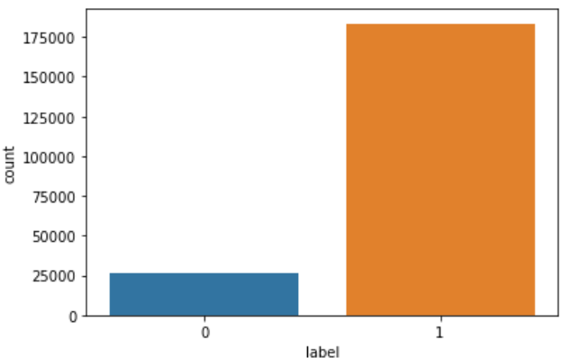
Visualizations
For the categorical data count plot is used to observe the relationship between input and target data.
Count Plot:

Slide 6
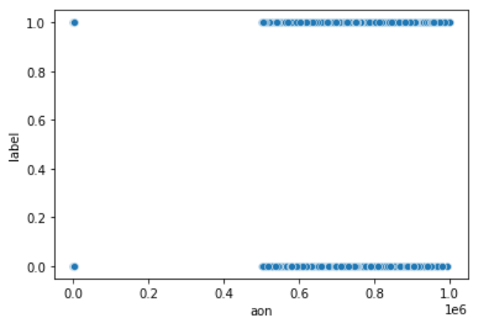
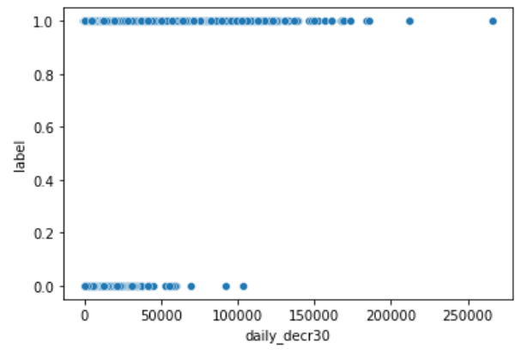
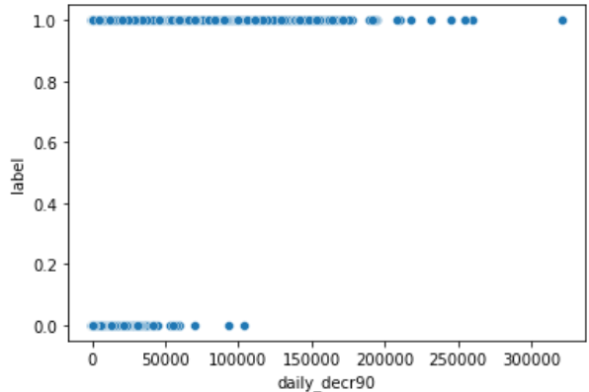
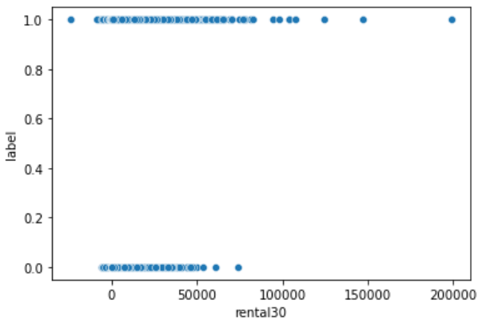
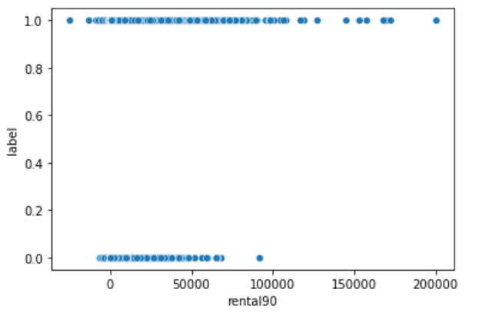
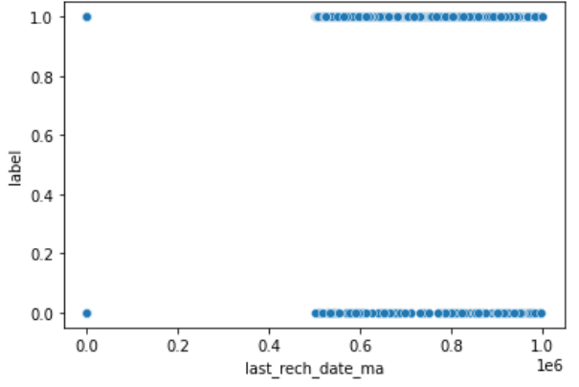
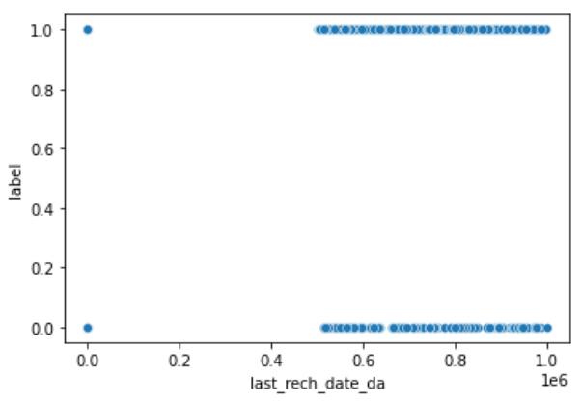
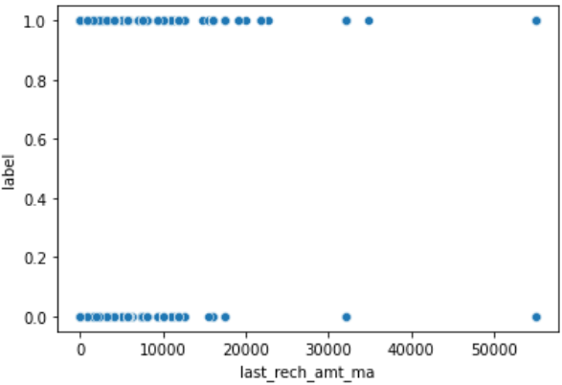
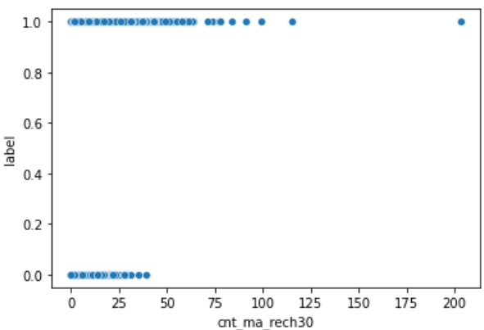
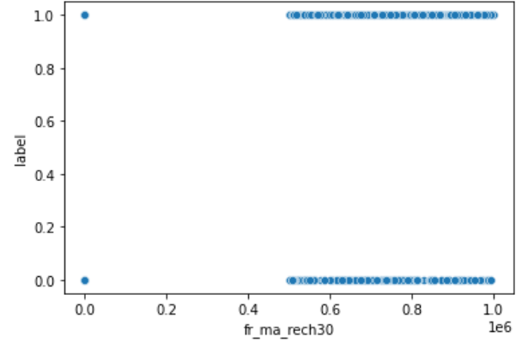
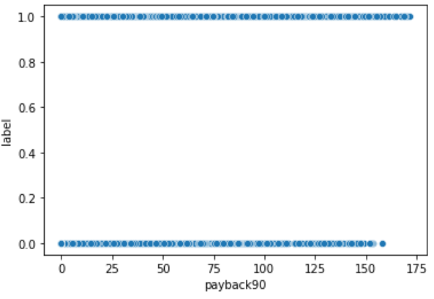
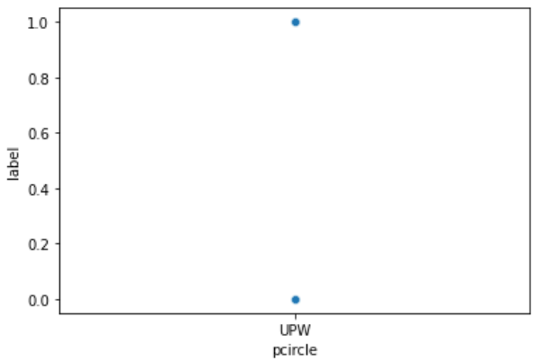
Visualization
Scatter Plot:

Slide 7
Steps and Assumptions used
Label Encoding: The data in label form is converted into numeric form which is in machine-readable form.
There are no null values present in the dataset.
Correlation: Finding the correlation between the target and input columns.
Describe of dataset: This gives the mean, standard deviation, maximum and minimum value.
Outliers: Outliers have been checked using box plot and the outliers present have been removed by z-score technique.
Skewness: Skewness has been checked using normal distribution curve and been removed using power transform method.
Dropping the columns: The columns which are not correlated to the target column have been deleted.
The dataset has been divided into features and vectors.
Data scaling is done using standard scaler.
Building the model using classification technique and the best model is saved.

Slide 8
Model Dashboard
Classification models are used to predict the customer retention in this project.
Logistic Regression: It gives the relationship between the dependent and independent variables. It is used when the value of the target variable is categorical in nature.
Decision Tree Classifier: It is a tree-structured classifier, where internal nodes represent the features of a dataset, branches represent the decision rules and each leaf node represents the outcome.
Random Forest Classifier: It consists of many decision trees. It uses bagging and feature randomness when building each individual tree and try to create an uncorrelated forest of trees whose prediction by committee is more accurate than that of any individual tree.

Slide 9
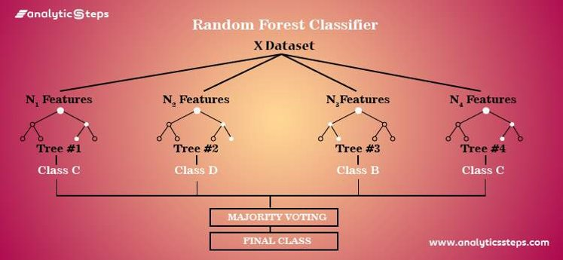
Finalised Model
Random Forest Classifier is chosen as a best model with 95% accuracy.

Slide 10
Conclusion
This research was conducted to predict the micro credit loan defaulter from the given dataset.
Random Forest gave the best model with 95% prediction accuracy.

